Slide 1

NYC PROPERTY SALES ANALYSIS
By Noora

Slide 2

SCENARIO
A real estate analytics company is preparing a market report on property sales across New York City using transaction data from September 2016 to August 2017. The results will be used to provide stakeholders with a view of patterns in the NYC property market.

Slide 3
OBJECTIVES
  How do property sale prices vary across New York City boroughs?
  Which NYC neighborhoods had the highest number of property sales?
  Which building ages had the highest number of property sales?
  How did the number of property sales change each month?
  Which type of property had more sales: residential or commercial?

Slide 4
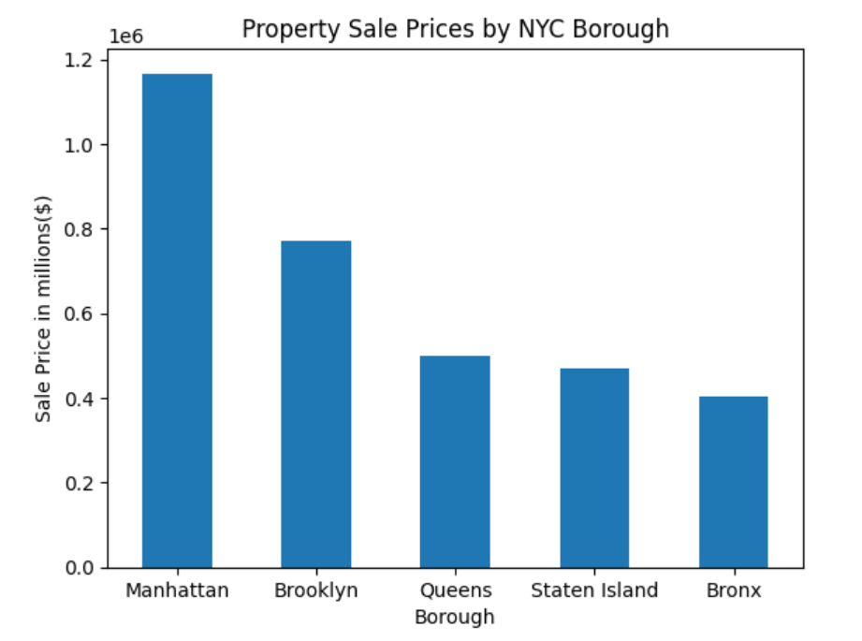
  HOW DO PROPERTY SALE PRICES VARY ACROSS NEW YORK CITY BOROUGHS

Slide 5
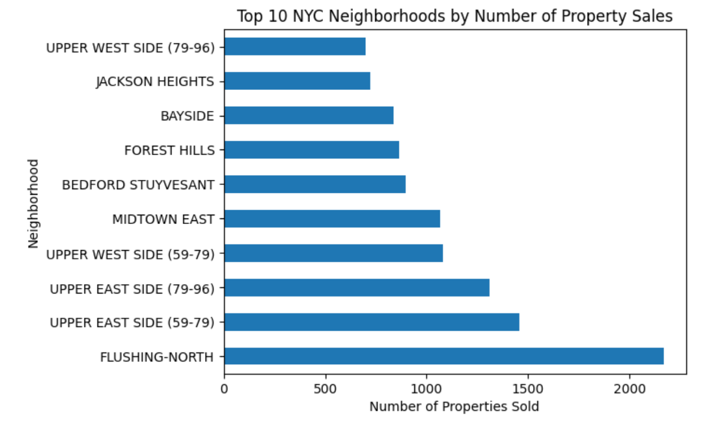
  WHICH NYC NEIGHBORHOODS HAD THE HIGHEST NUMBER OF PROPERTY SALES?

Slide 6
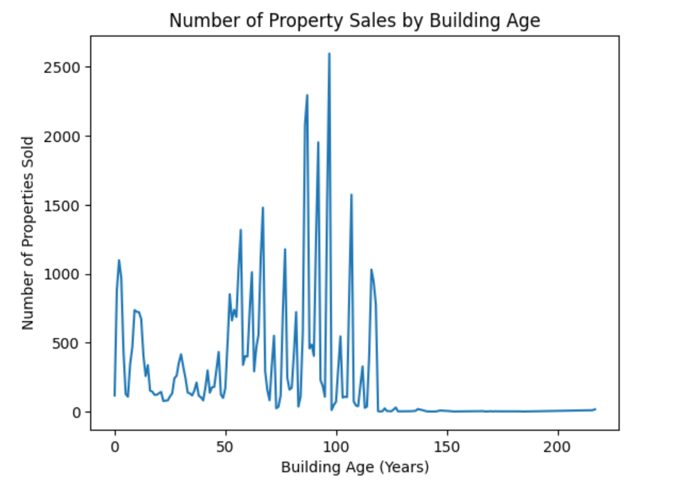
  WHICH BUILDING AGES HAD THE HIGHEST NUMBER OF PROPERTY SALES?

Slide 7
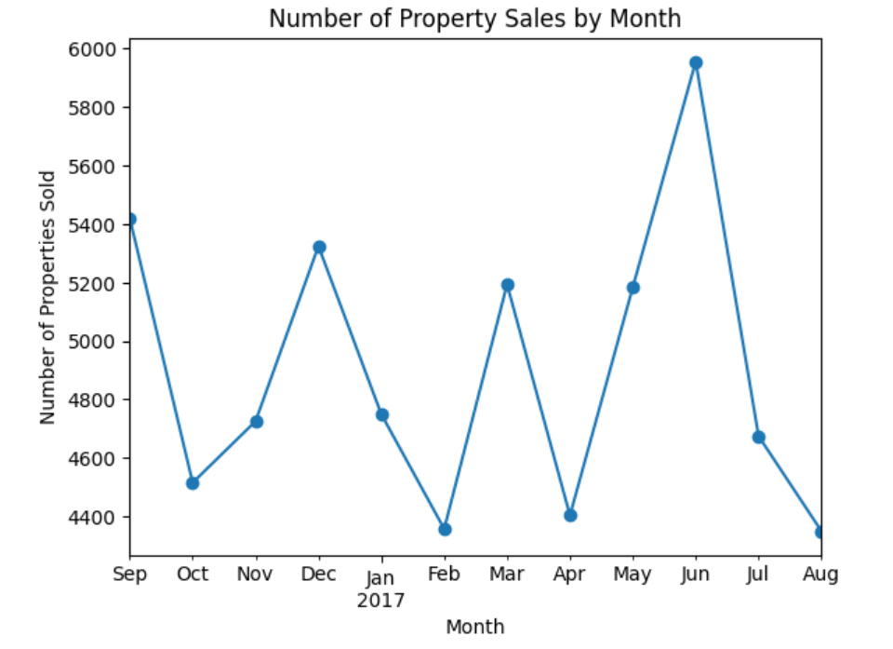
  HOW DID THE NUMBER OF PROPERTY SALES CHANGE EACH MONTH?

Slide 8
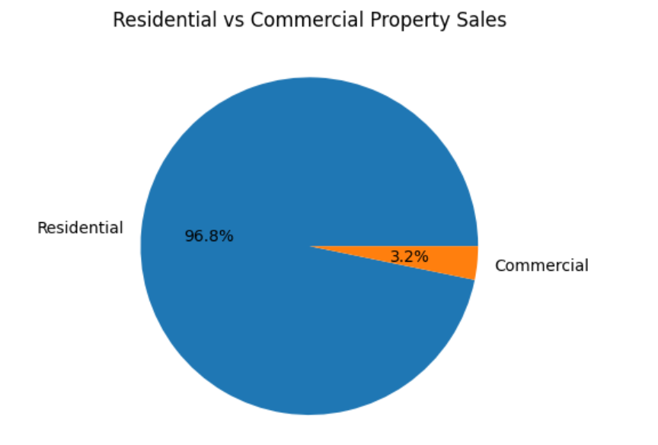
  WHICH TYPE OF PROPERTY HAD MORE SALES: RESIDENTIAL OR COMMERCIAL?

Slide 9
CONCLUSION
  Analyze time periods because sales activity changes throughout the year.
  Use building age as an additional factor, but not as the only explanation for prices.
  Remember that high sales activity does not always mean higher property prices.

Slide 10
THANK YOU

